Slide 1



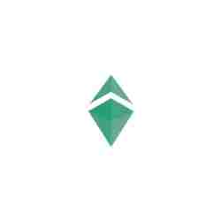

DROPYDOGE
THE MASTER OF THE FUTURE

Slide 2
DROPYDOGE
Dropydoge; It is a multi-purpose project built on the Binance smart chain and then designed to switch to its own blockchain infrastructure. Dropydoge is working on 5 main projects for use in the real world. These are as follows: ✅DODESWAP ✅DODESALE ✅NFT & GAMING ✅METAVERSE ✅E-COMMERCE

Slide 3
5 OUR MAIN GOALS
DODESWAP
DODESALE
E Commerce
NFT GAMING
METAVERSE

Slide 4

DODESWAP
Dode Swap allows you to instantly swap any asset supported on DropyDoge with any other digital asset supported on our platform. Both ER-C20 and BEP-20 will support. For example DODE/BNB or DODE/DOGE, DODE/SHIBA; BEP20/ERC20 this is entirely up to you. These swap transactions will be made on the trustwallet at first, and then they will start on their own DODEWALLET.
Thus, as the amount of assets entering the dode increases, the volume of the dode will also increase. This is an indispensable discipline for our future plan.

Slide 5

DODESALE
We will create a brand new platform for the DODEsale ecosystem. Like this,
Real or legal persons that issue tokens will be able to make their pre-sales more economically thanks to this platform. All platforms will prefer us because we will offer multi-purpose solutions.

Slide 6

DODE NFT
With the incredible speed of technology, the digital transformation seen in every field seems to have spread to the art world as well. In today's digital world, where cryptocurrencies are just beginning to be understood and widespread, we are now faced with a new digital asset: NFTs. These new assets, known as non-fungible tokens and referred to as crypto art, mean that various data such as pictures, audio, video are written to the blockchain in a digital environment and these data are digitally certified. In other words, NFTs are digital artworks whose authenticity is verified by blockchain on the internet and put up for sale in digital marketplaces, our team will set up a separate budget for this and will be released by creating professional NFTs.

Slide 7
DODE METAVERSE
It is a platform where users can move in a digital and augmented reality virtual universe, while many elements of technology will push the limits.
Metaverse providers envision their users to work, play, and stay connected during virtual world trips such as concerts, conferences, and business meetings, or with friends. “We are now at the next internet pinnacle,” Matthew Ball, managing partner at venture capital firm Epyllion Industries, wrote on his website in February 2021. said.
Of course, we can't hold back because that's exactly the world we're going to build. They'll spend dode tokens when purchasing a real estate asset in the metaverse.

Slide 8
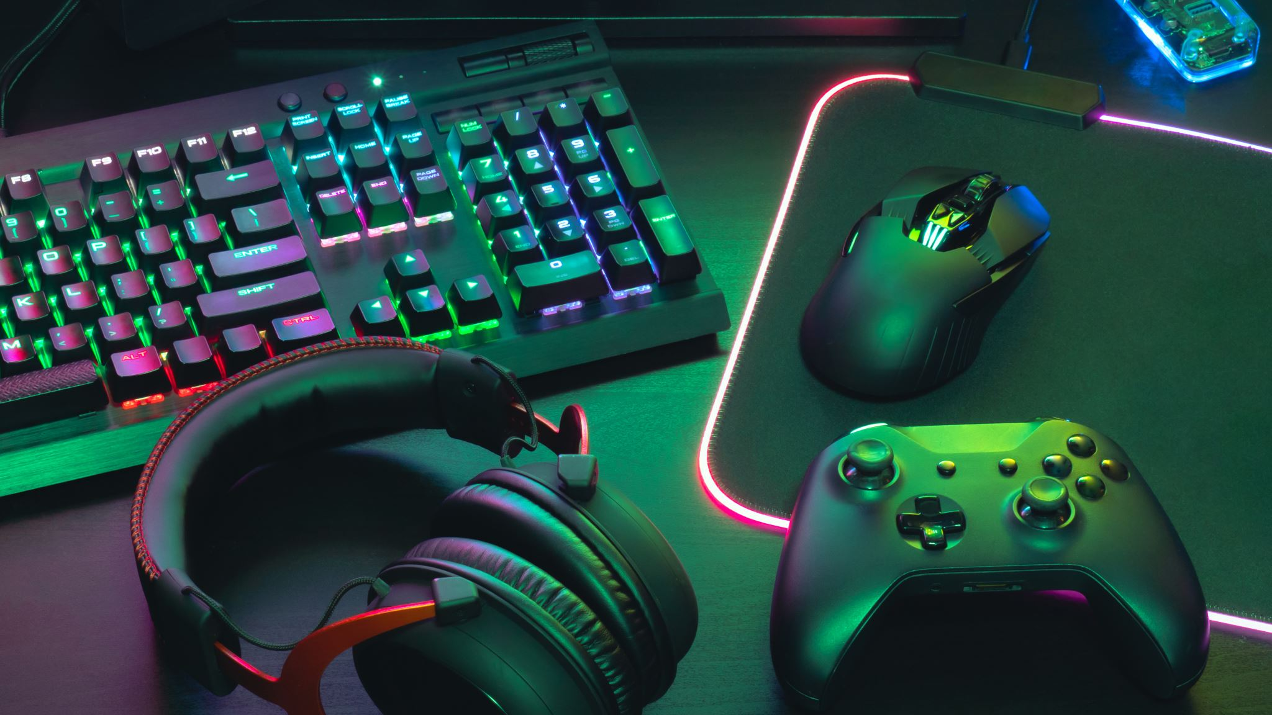
DODE GAMING
We will partner with the most popular game companies. Players can earn DODE cryptocurrency by playing the game.
These dodes they earn can be exchanged for another asset on DODESWAP or they can purchase products on e-commerce sites that we are partners with.

Slide 9
E-COMMERCE
E-commerce is the method that people can choose with its many conveniences, we will have our own e-commerce website, and users will be able to use dode tokens while purchasing products on this site.

Slide 10
TOKEN
Total tokens: 1 SEXTILLION
Pre-sale: 400 QUINTILLION
Locked: 370 QUINTILLION
Burn: 8 QUINTILLION

Slide 11
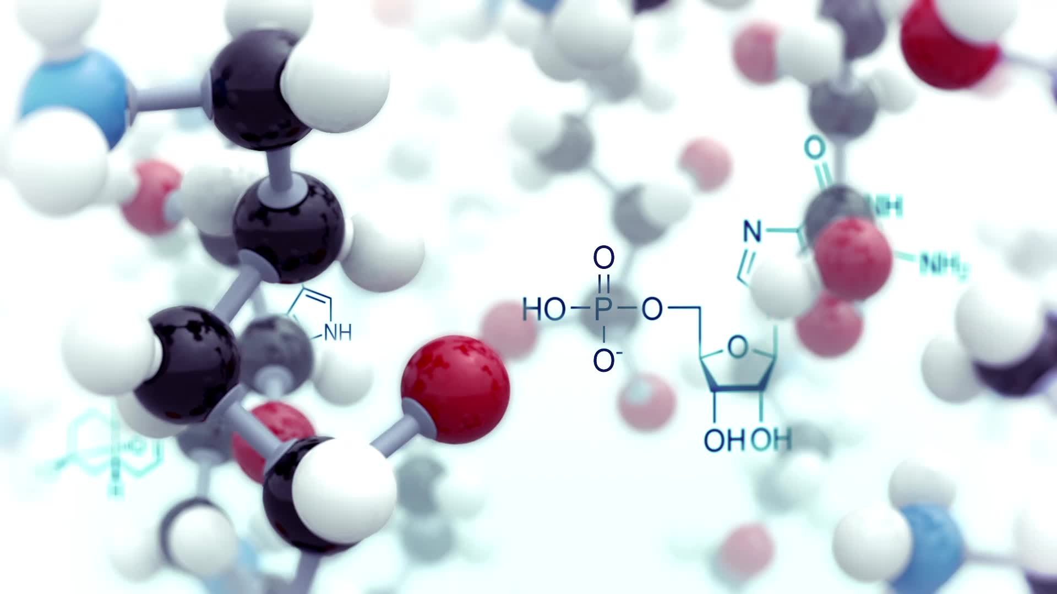
DODE PRESALE
Soft cap: 50 BNB
Listing On Pancakeswap v2
Liquidity Percent %51
Liquidity Unlocked Time 400 DAYS
Pre-sale link: https://l24.im/HG8
Slippage buy&sel 12

Slide 12
DODE ROADMAP
V1
Unique team building
Social media setup
Website Launch
marketing campaign

Slide 13
V2
BscScan launch
CEO KYC. TEAM PRIVATELY DOXED and TECHRATE-AUDIT
Creating a whitelist
Pre-sale preparation (pinksale

Slide 14

V3
isting pancakeswap v2
Marketing promotions
Coinecko listing
Coinmarketcap listing

Slide 15

V4
Website renewal for integrated
Certik_io technical audit
Integration with ETH/Matic/Polygon/Kucoin to increase the speed of transactions
First CEX Lists

Slide 16
V5
Start DODESWAP
Establishment of the DODEsale ecosystem
NFT market release and hello Game world
First step into the world of the Metaverse
DODE E-COMMERCE

Slide 17
OUR COMMUNICATION CHANNELS
http://dropydoge.com/
https://www.facebook.com/dropydoge
https://t.me/dropydoge
https://twitter.com/dropydoge
https://www.instagram.com/dropydoge
https://www.reddit.com/user/DropyDoge
https://www.tiktok.com/@dropydoge
https://discord.com/channels/dropydoge

